Slide 1
US Trade Summary
March 2017

Slide 2
What Does Trade Mean to Iowa?
Iowa ranks #4 on per capita Ag exports
Iowa Ranks #5 on percent of Exports that come from Ag and Ag Products.
Iowa currently exports $ 5.4 Billion of agricultural commodities*;
9.4% of Iowa’s direct employment and 13.0% of Iowa’s direct value-added are connected to these exports.
41% of exports leaving from Iowa are commodities and ag-based products
Per capita exports out of Iowa are ranked 4th in the nation with $1,734 exported per person.
If both direct and indirect effects are considered, Iowa ag exports are responsible for 21.0% for employment and 24.4% for value-added.
*Based on a selection of ag products from the U.S. Census Bureau,

Slide 3
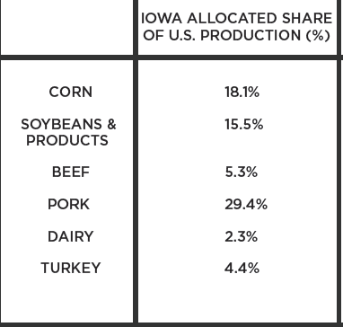
Where Do Iowa’s Top Commodities Go?

Slide 4
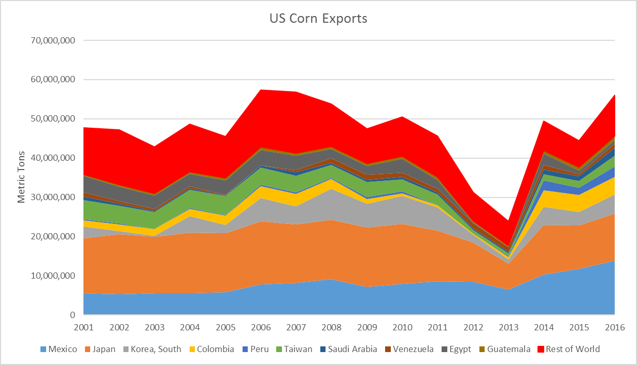
US Corn Exports
2001-2016
Top Destinations & Rank
  (2001 – 2016)
  Mexico (2 – 1)
  Japan (1 – 2)
  South Korea (5 – 3)
  Columbia (7 – 4)
  Peru (NR – 5)
  Taiwan (3 – 6)
  Saudi Arabia (NR – 7)
  Venezuela (10– 8)
  Egypt (4 – 9)
  Guatemala (NR – 10)
  ROW (2 – 3)
  Canada (6 – NR)
  Algeria (8 – NR)
  Dominican Rep (9 – NR)

Slide 5
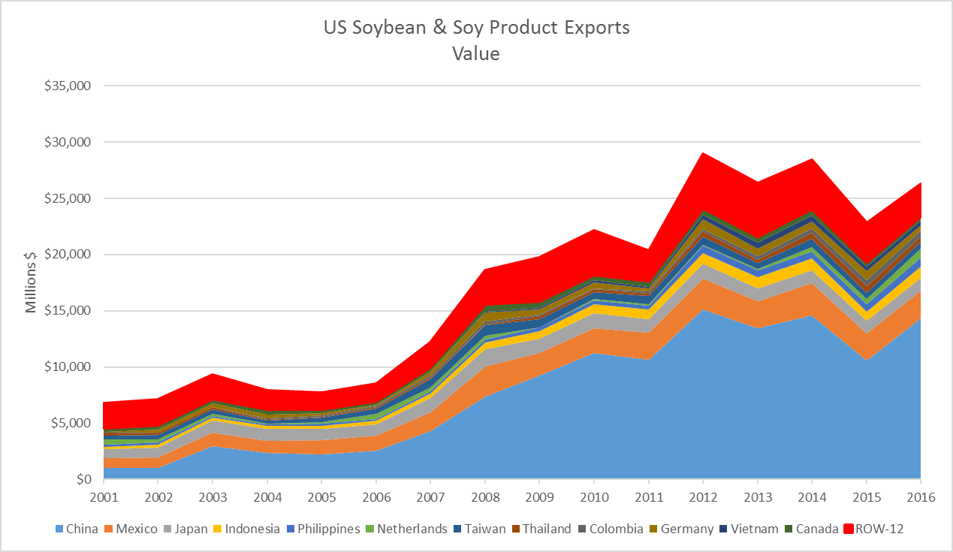
US Soybean Exports
Top Destinations & Rank
  (2001 – 2016)
  China (1 – 1)
  Mexico (2 – 2)
  Japan (3 – 3)
  Indonesia ( 8 – 4)
  Philipines (10 – 5)
  Netherlands (4 – 6)
  Taiwan (5 – 7)
  Thailand (11 – 8)
  Columbia (NR – 9)
  Germany (NR – 10)
  Vietnam (NR – 11)
  Canada (6 – 12)
  ROW-12 (1 – 3)
  Spain (7 – NR)
  S. Korea (9 – NR)

Slide 6
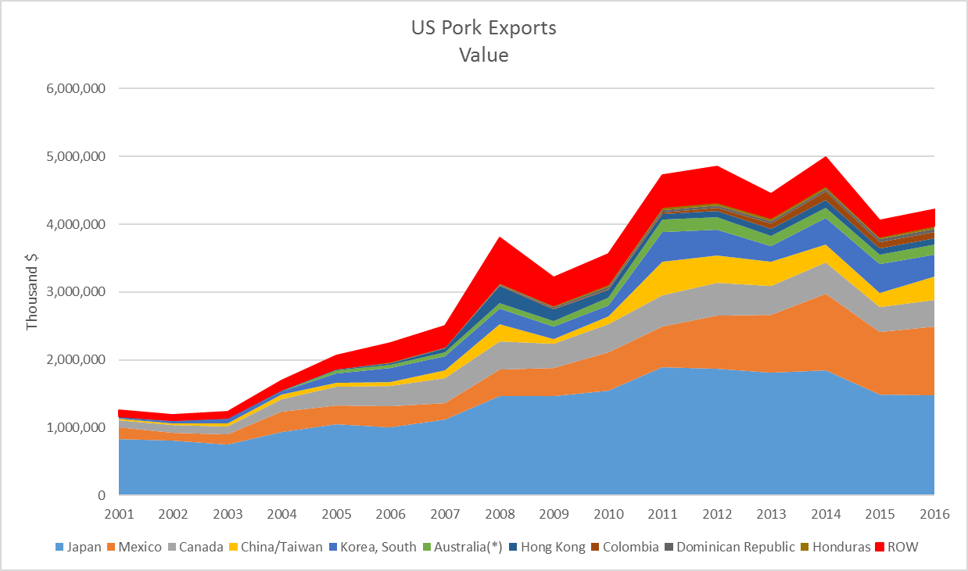
US Pork Exports
Top Destinations & Rank
2001-2016
  Japan (1 – 1)
  Mexico (2 – 2)
  Canada (3 – 3)
  China/Taiwan (5 – 4)
  S. Korea (6 – 5)
  Australia (NR – 6)
  Hong Kong (7 – 7)
  Columbia (NR – 8)
  Dom Rep (NR – 9)
  Honduras (8 – 10)
  ROW (4 – 6)
  Russia (5 –NR)

Slide 7
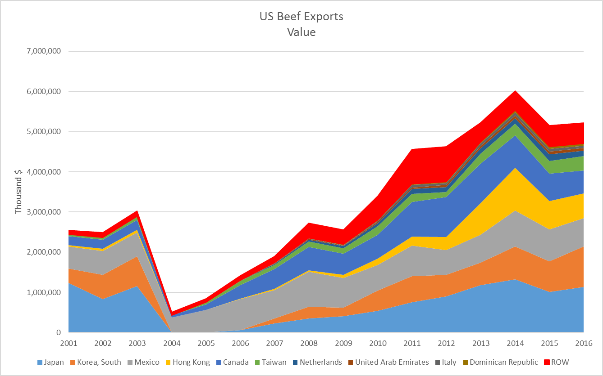
US Beef Exports
Top Destinations & Rank
  (2001 – 2016)
  Japan (1 – 1)
  S. Korea (3 – 2)
  Mexico (2 – 3)
  Hong Kong (5 – 4)
  Canada (4 – 5)
  Taiwan (6 –6)
  Netherlands ( NR – 7)
  UAE (NR – 8)
  Italy (NR – 9)
  Dom Rep (NR – 10)
  ROW (5 – 6)
  Bahamas (7 – NR)
  Russia (8 – NR)
  Bermuda (9 – NR)
  Singapore (10 – NR)

Slide 8
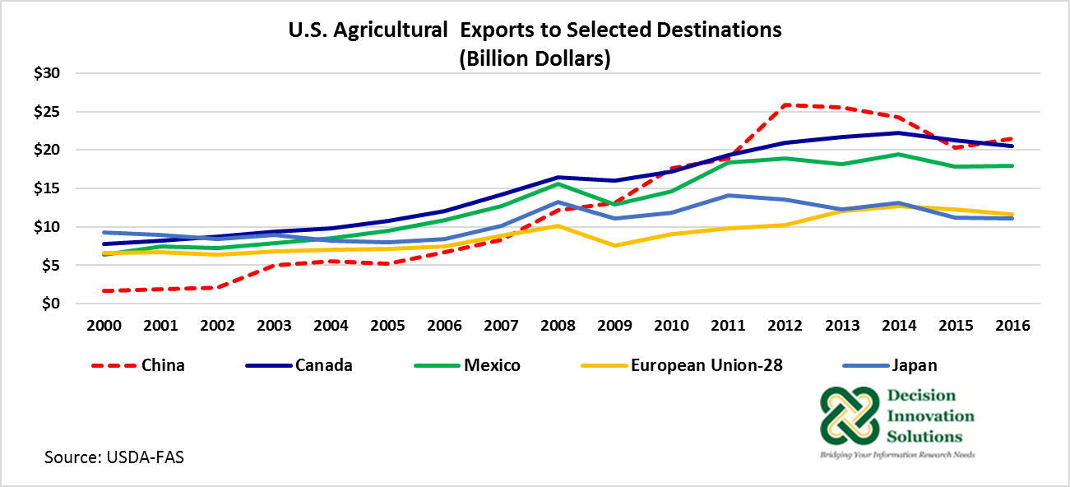

Slide 9
What is the Status of Trade with the Major Markets for US Products

Slide 10
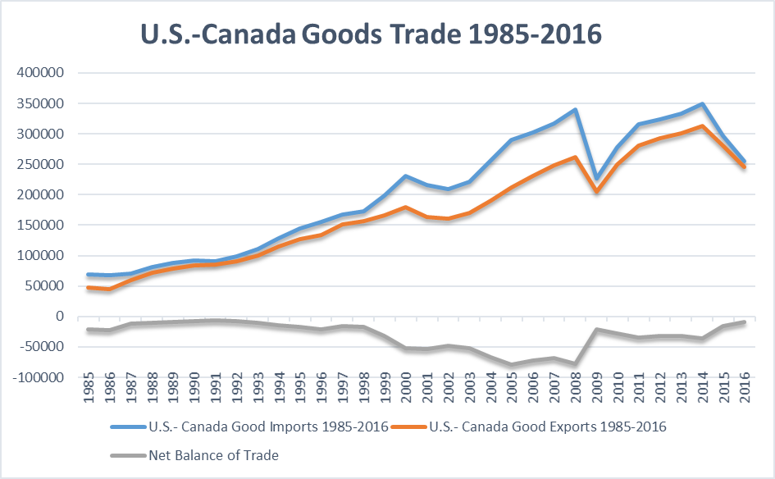
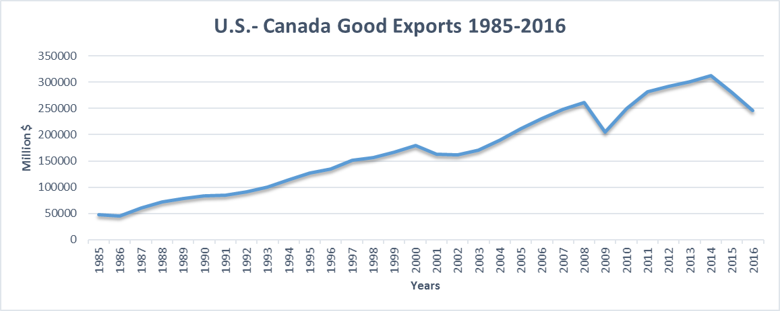
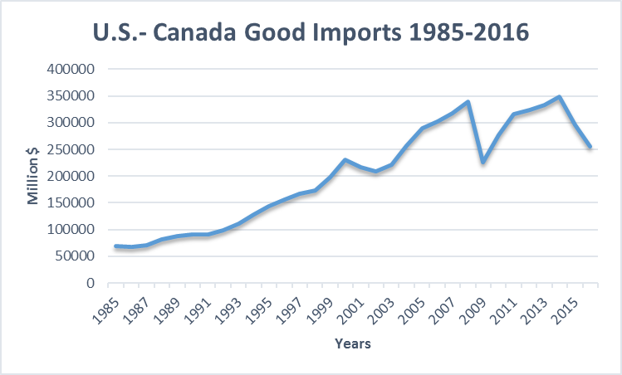

Slide 11
U.S.- Canada Ag Trade

Slide 12
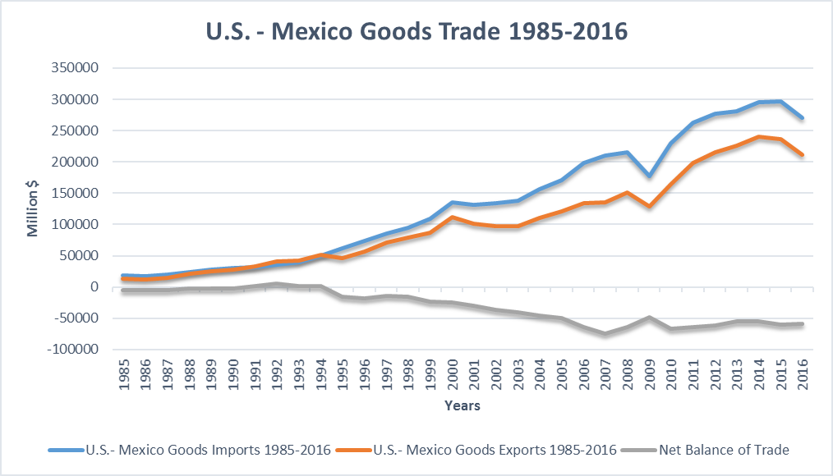
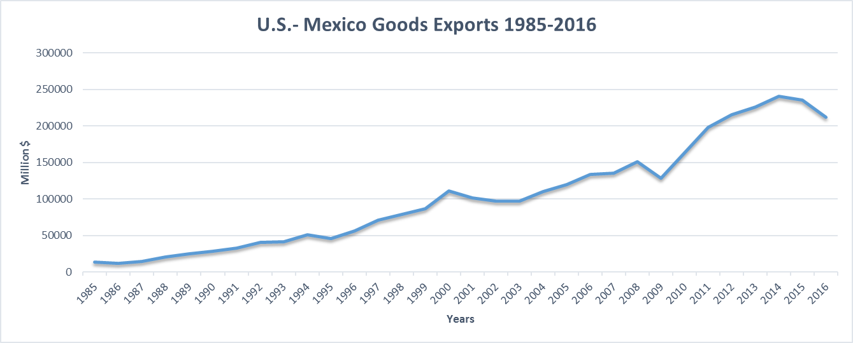
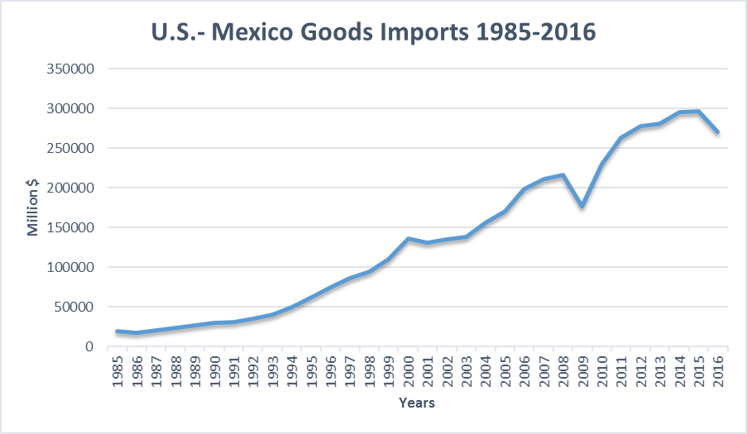

Slide 13
U.S. Mexico Ag Trade

Slide 14
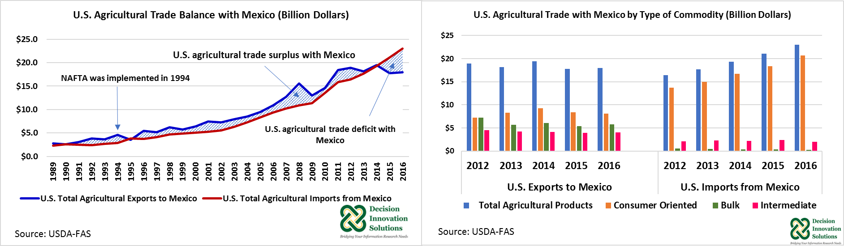

Slide 15
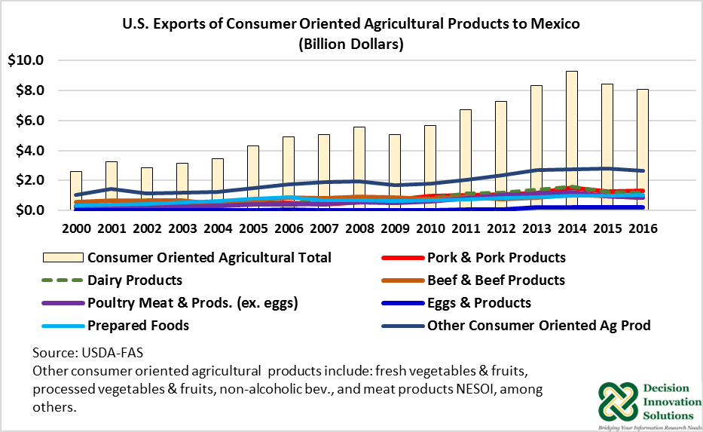
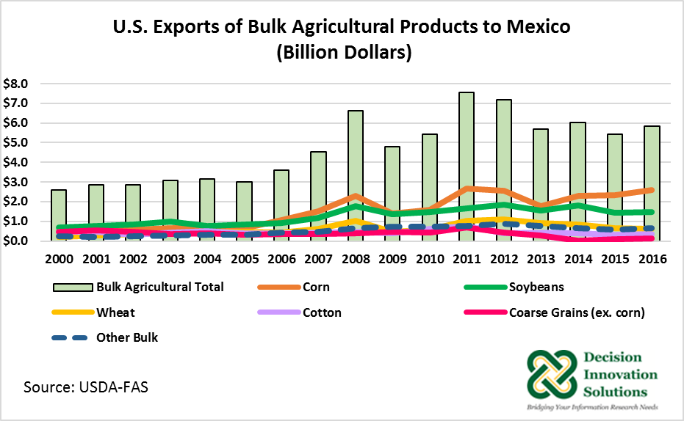
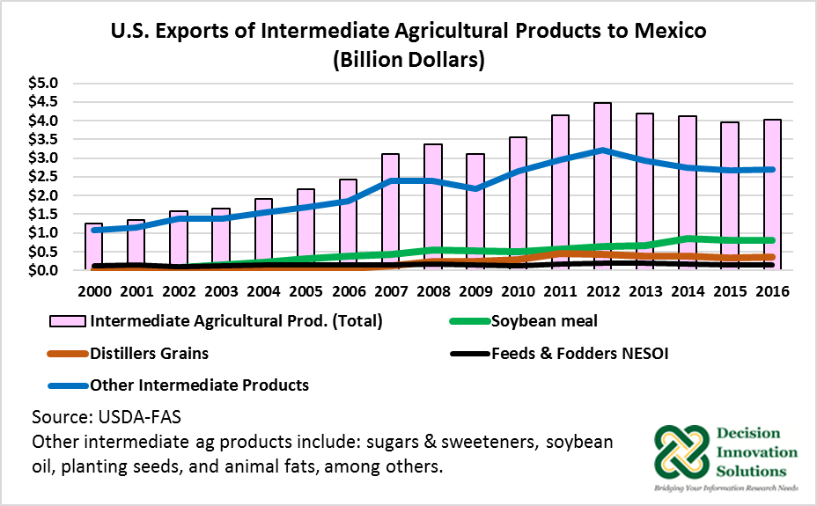

Slide 16
2016 U.S. Agricultural Exports to the World and Mexico: Selected Commodities, Mexico’s Rank, and Share of U.S. Total

Slide 17
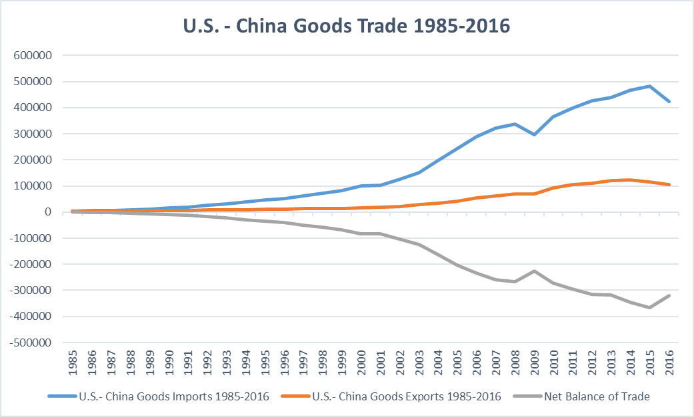
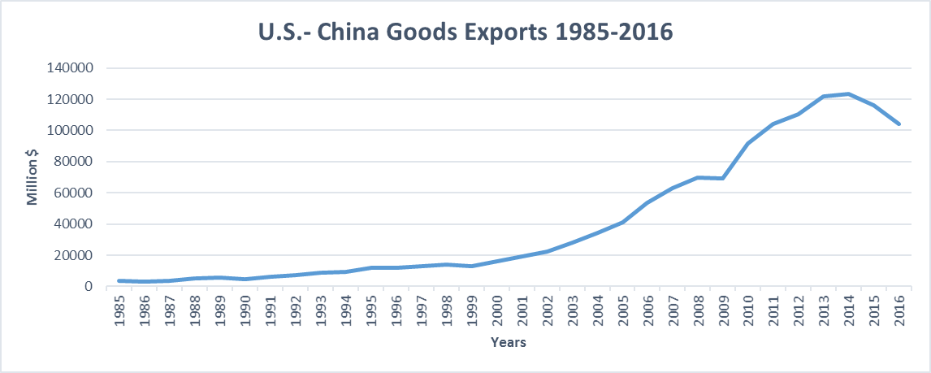
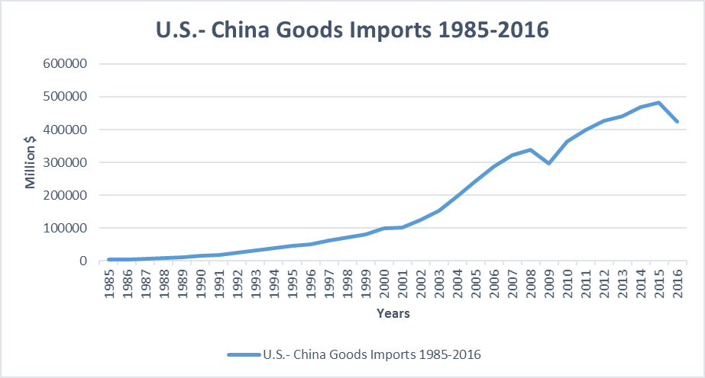

Slide 18
U.S. – China Ag Trade

Slide 19
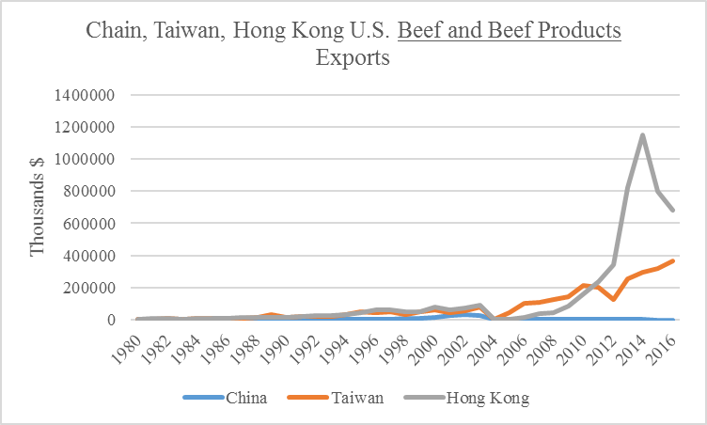
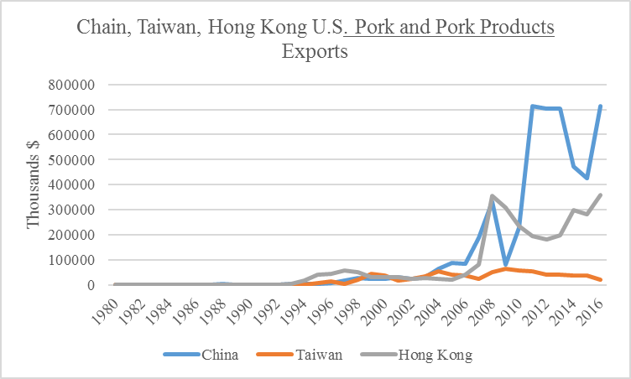
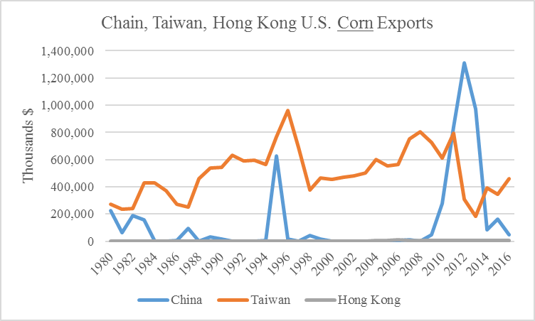
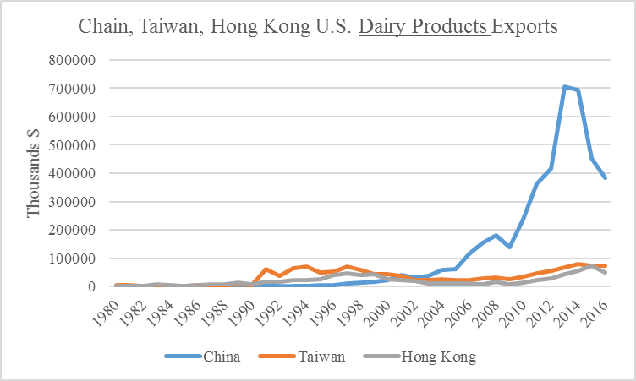
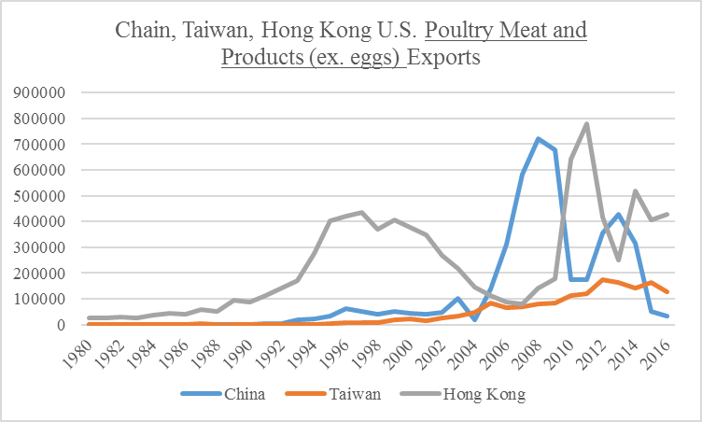
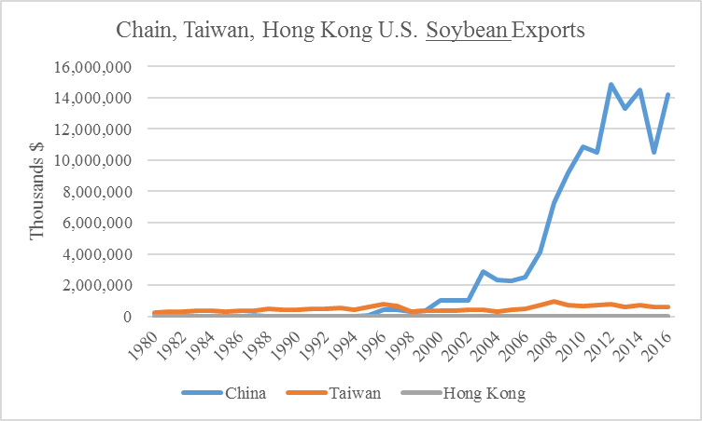
US Exports to - China/HongKong/Taiwan Trade

Slide 20
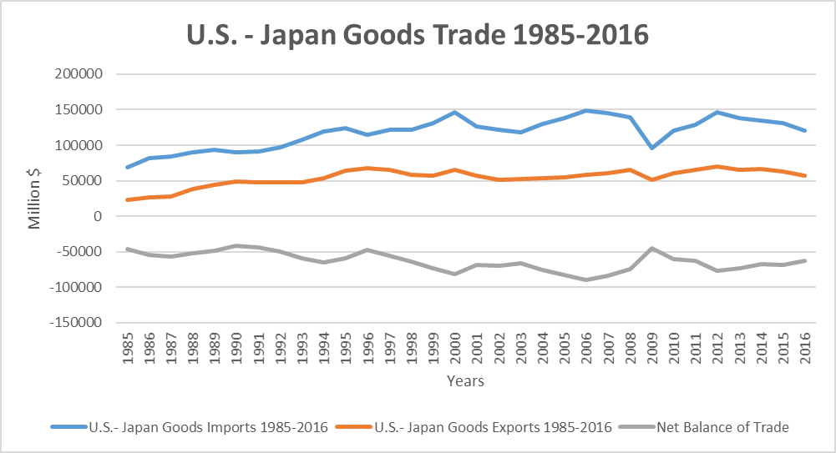
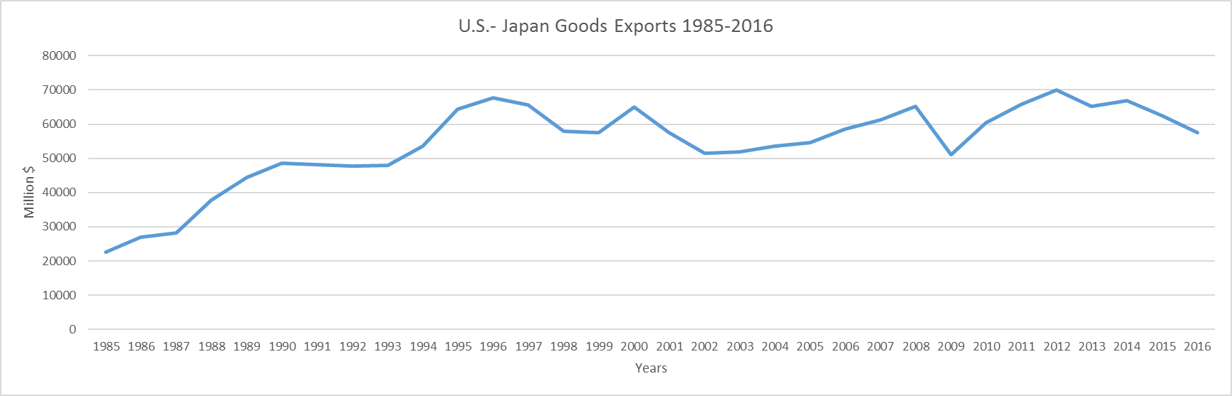
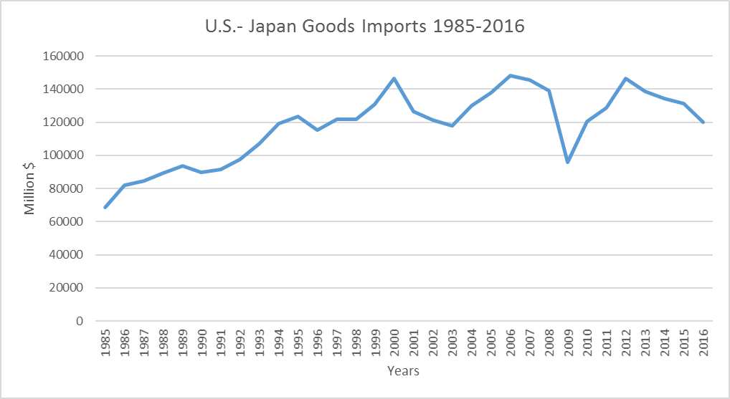

Slide 21
U.S. –Japan Ag Trade

Slide 22
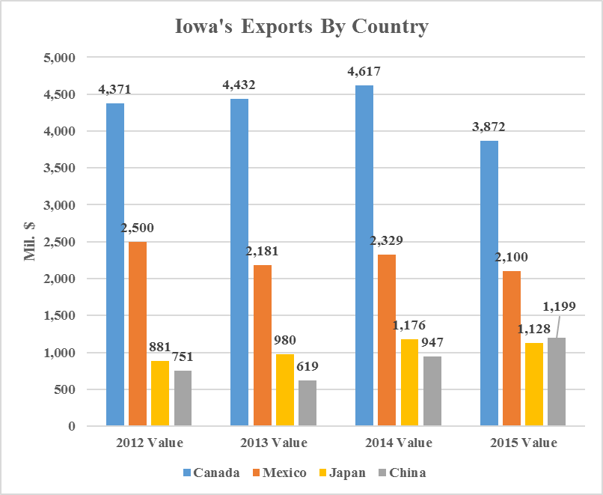

Slide 24
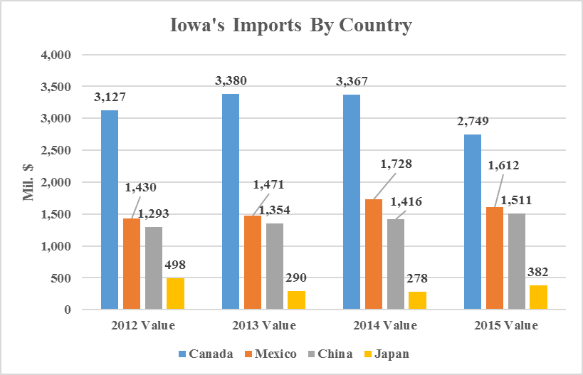

Slide 26
Trade Summaries with Countries for which the US has an active FTA

Slide 27
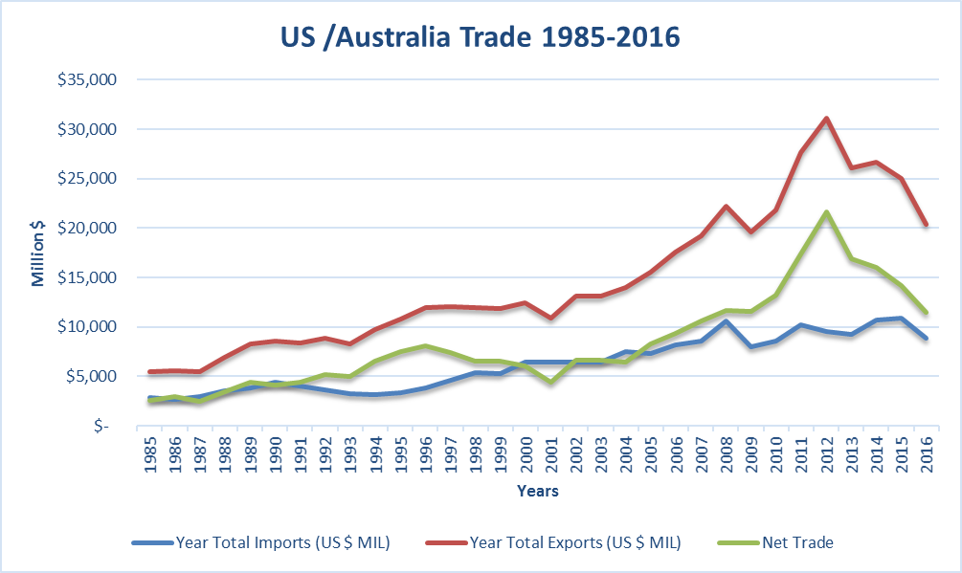
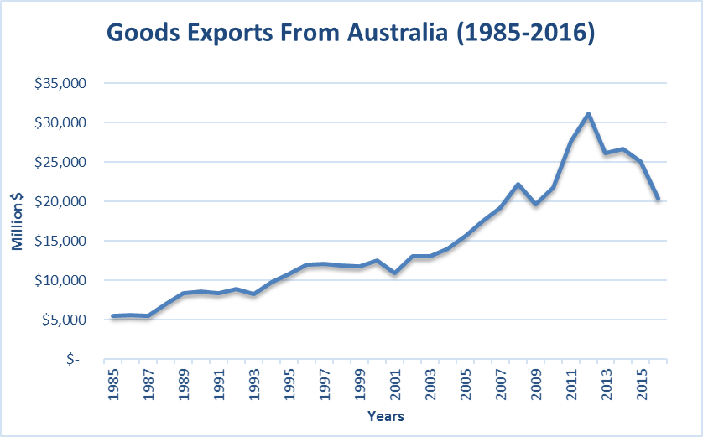
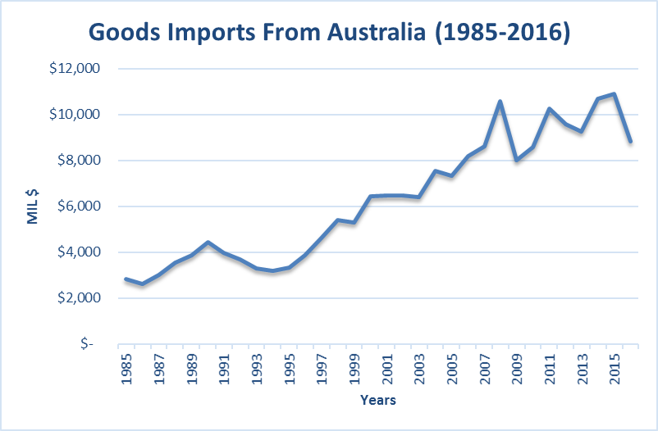

Slide 28
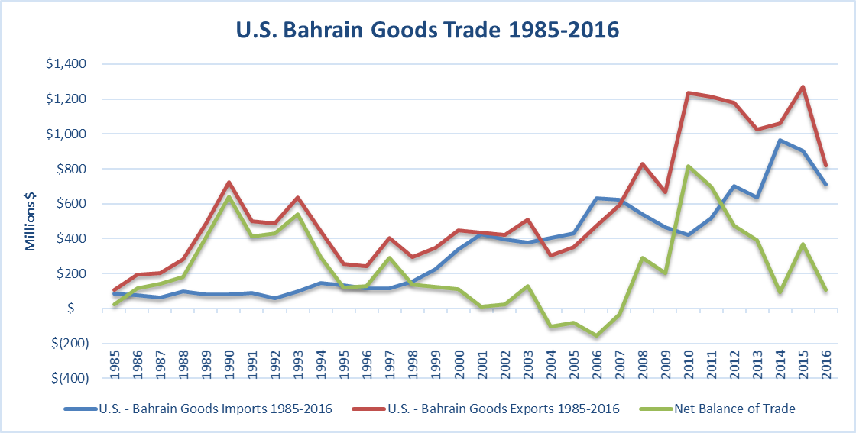
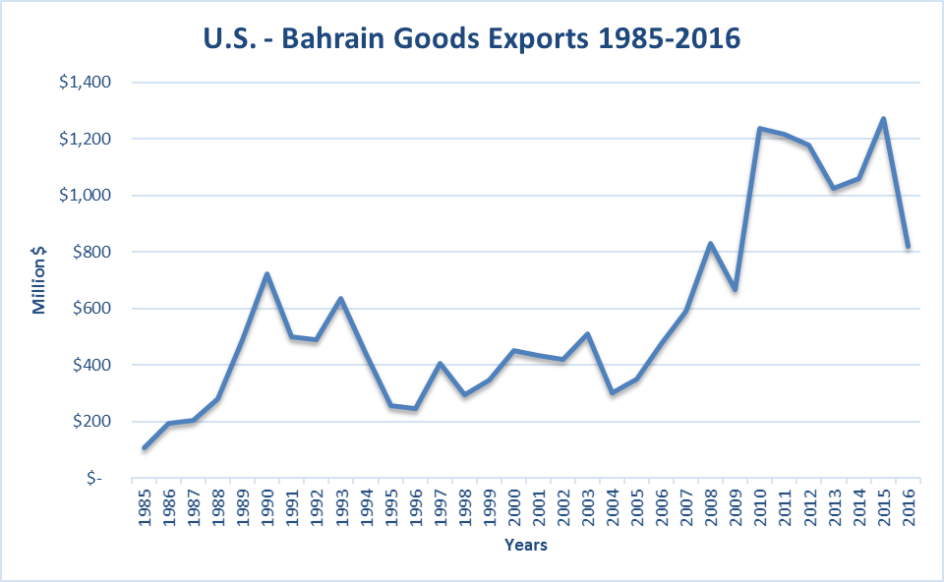
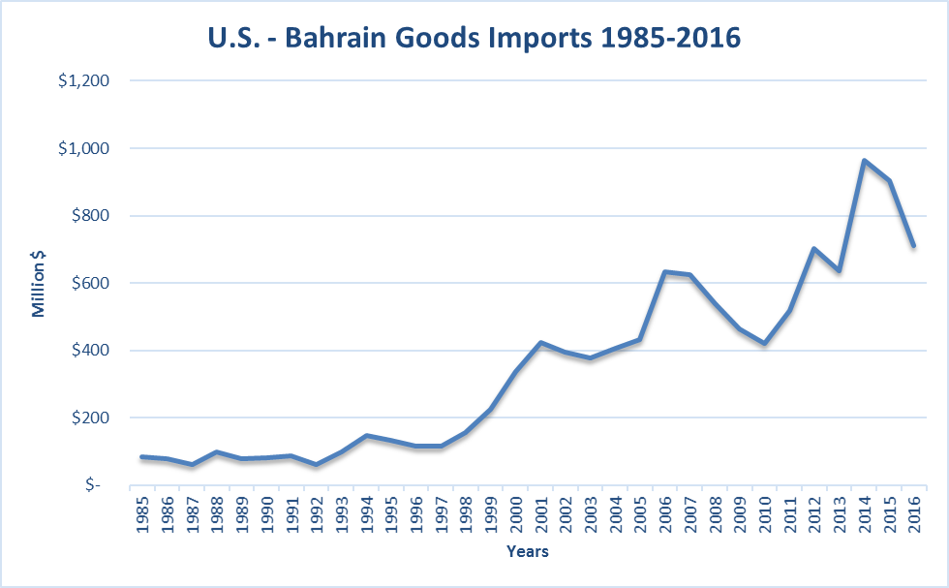

Slide 29
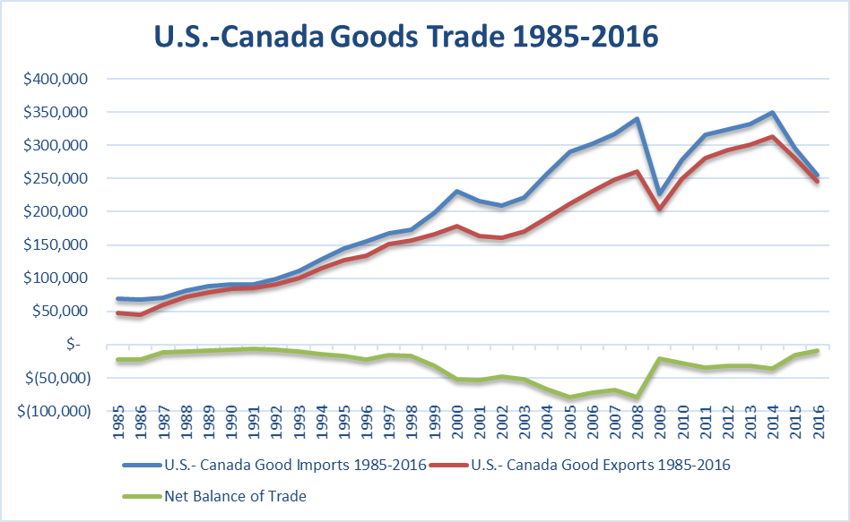
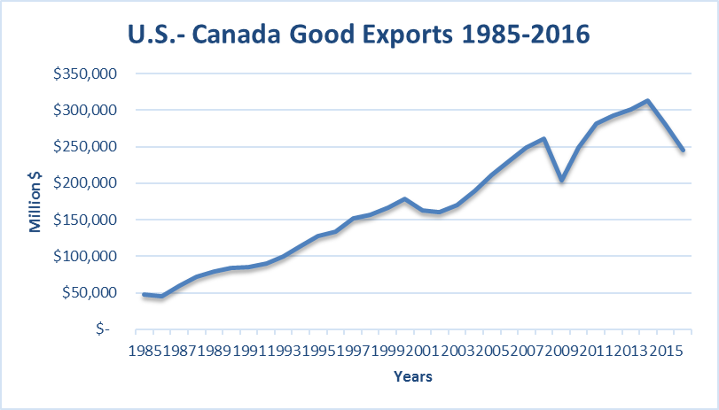
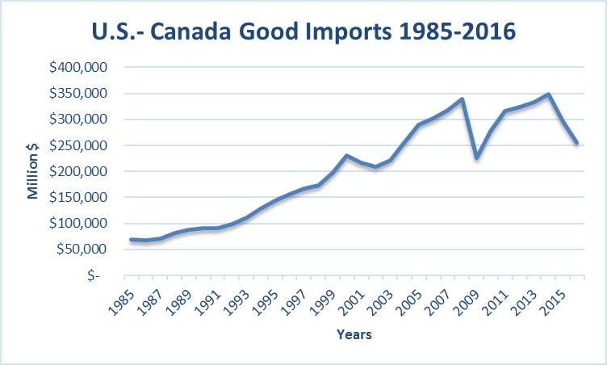

Slide 30
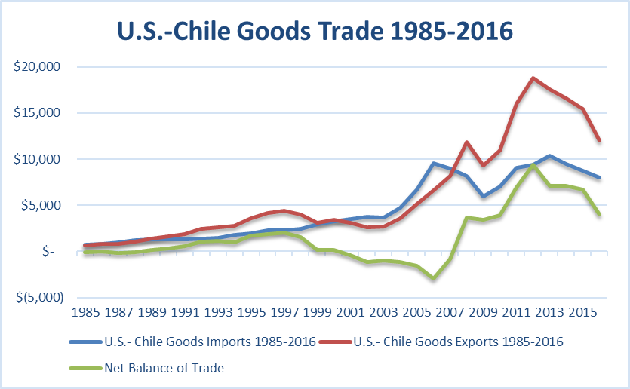
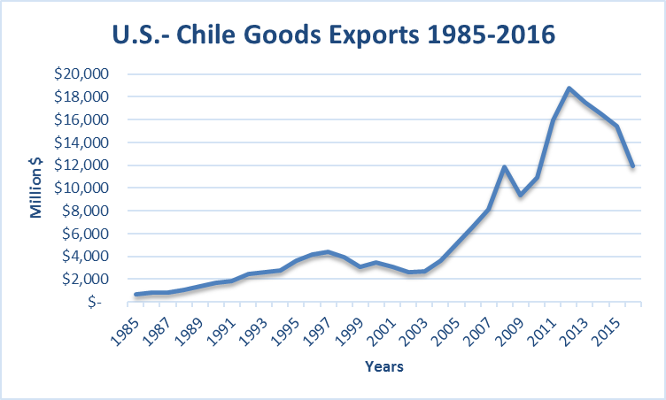
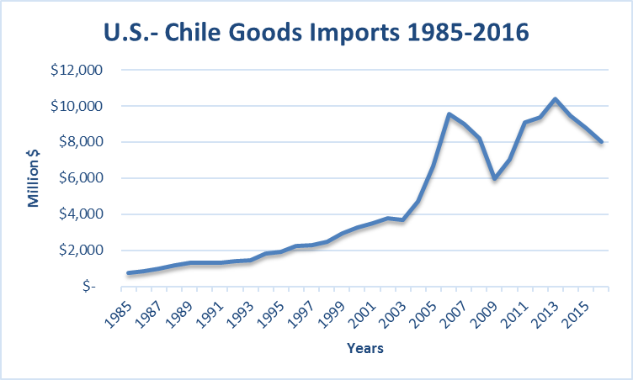

Slide 31
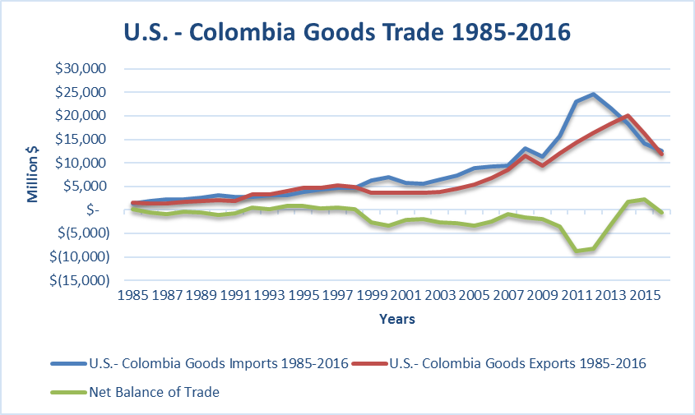
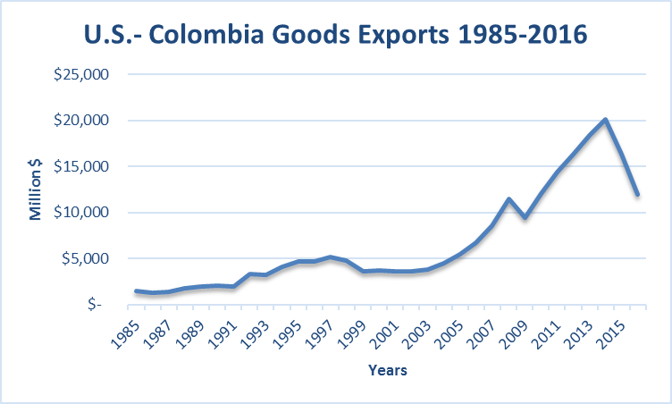
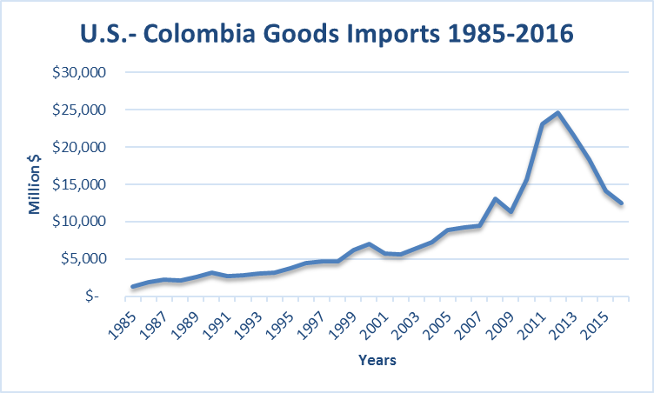

Slide 32
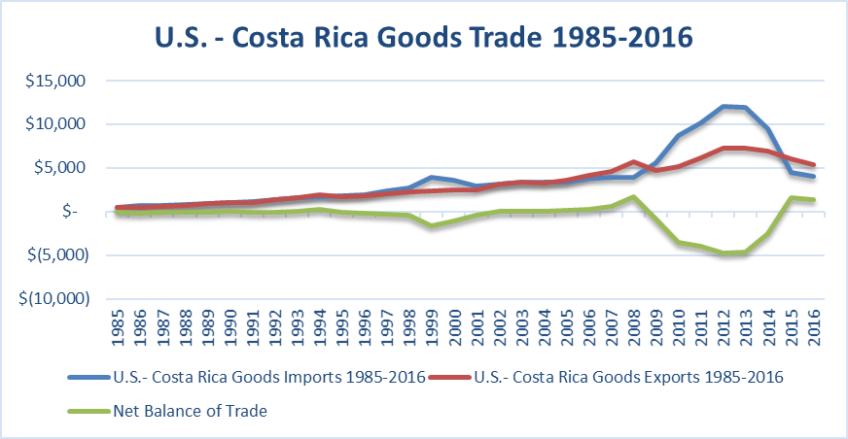
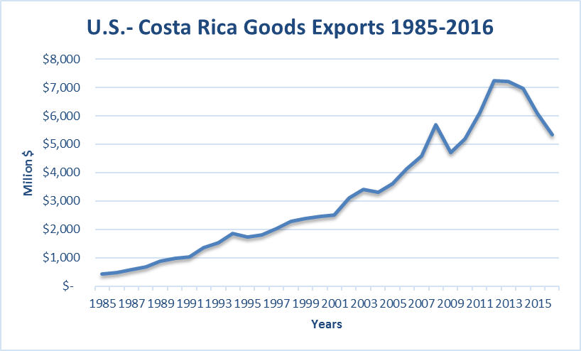
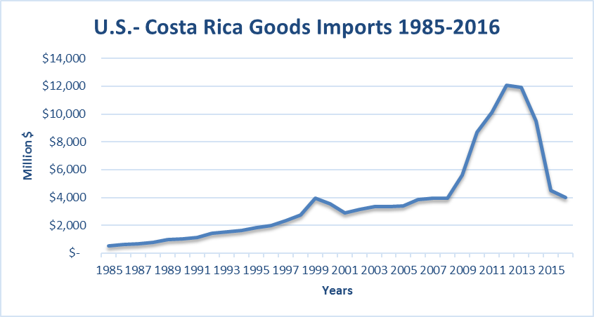

Slide 33
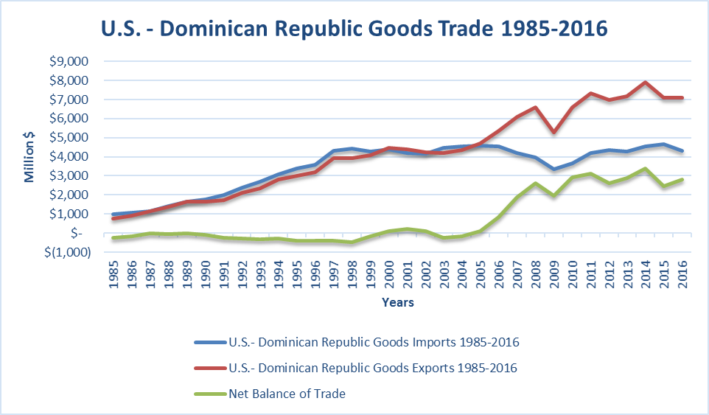
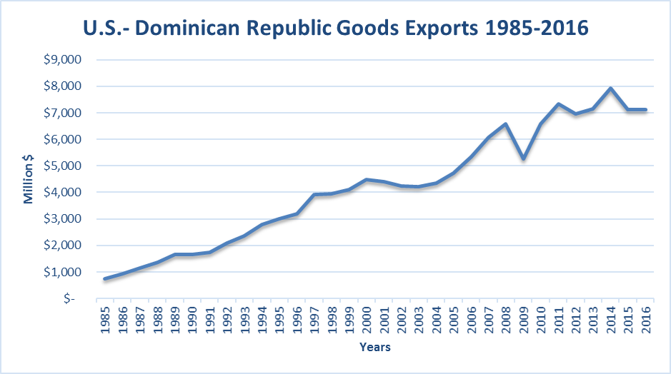


Slide 34




Slide 35




Slide 36




Slide 37




Slide 38




Slide 39




Slide 40




Slide 41




Slide 42




Slide 43




Slide 44




Slide 45




Slide 46




Slide 47
Summary of US Trade with Countries for which we do NOT have an FTA

Slide 48




Slide 49




Slide 50




Slide 51




Slide 52




Slide 53




Slide 54




Slide 55




Slide 56




Slide 57




Slide 58




Slide 59
TPP & Japan – What now?
U.S. already has trade agreements in place with six of the TPP member countries: Australia, Canada, Chile, Mexico, Peru and Singapore.
But the U.S. isn’t the only TPP member that has been aggressively negotiating trade agreements;
all TPP members are currently negotiating RTAs outside of TPP.
For example, Japan has signed 12 regional and bilateral free trade agreements.
  Partners include Singapore, Mexico, Malaysia, Chile, Thailand, Indonesia, Brunei, the Association of Southeast Asian Nations (ASEAN), the Philippines, Switzerland, Vietnam, India, Peru, Australia and Mongolia. In addition, Japan is negotiating agreements with Canada, Colombia, China, the European Union, Regional Comprehensive Economic Partnership (RCEP) nations and Turkey.

Slide 60
Key Trade Issues
TPP Countries
TTIP
Improved access
  Tariff reductions
    Vietnam (corn, soybeans soyoil, pork, poultry)
    Japan (beef, pork, poultry)
  Increase TRQs
    Japan (rice, dairy)
Biotechnology approval processes
Export subsidy elimination
Trade remedies
SPS measures
Dispute settlement processes
Geographic indicators
Sanitary & phytosanitary measures
Oppose geographic indicators
Oppose precautionary principle
Biotechnology product access
Eliminate non-tariff trade barriers
Hormones & beta agonists
Inspections
Include all ag products and policies in negotiations

Slide 61
NAFTA Update Issues
Address issues included in TPP
  Biotechnology
  Geographic indicators
  SPS measures
  Dispute resolution
Improved border crossing procedures

Slide 62



Slide 63



